Slide 2
CONTENT
Trying to present our knowledge of English and encourage other pupils to start learning it by showing that this language is far more than just a grammar and texts that we are doing on classes, we decided to create this magazine to prove that English can be fun. So, enjoy reading it and if you have any suggestions we would be happy to listen to them and input them into our project.
Thanks and happy reading. ☺
Music - Bleeding love……. ………..Avril………….Riblja corba
Entertainment - Jokes……….. Fact or Fiction
Animals - elephant……………siberian tigar
Interviews - PE Teacher…………
Film - Lost……
Sport - Introduction………….. Nemanja Vidic………….
Science page - Robots
Funny Horoscope - read about your future
My pet - Golden Retriever
Don’t be lazy be popular -winnisng translation
Don’t be lazy be popular - crossword

Slide 3
Music: art that makes our souls bloom
Bleeding Love"
Closed off from love
I didn't need the pain
Once or twice was enough
And it was all in vain
Time starts to pass
Before you know it you're frozen
But something happened
For the very first time with you
My heart melts into the ground
Found something true
And everyone's looking round
Thinking I'm going crazy
But I don't care what they say
I'm in love with you
They try to pull me away
But they don't know the truth
My heart's crippled by the vein
That I keep on closing
You cut me open and I
Keep bleeding
Keep, keep bleeding love
I keep bleeding
I keep, keep bleeding love
Keep bleeding
Keep, keep bleeding love
You cut me open
Trying hard not to hear
But they talk so loud
Their piercing sounds fill my ears
Try to fill me with doubt
Yet I know that the goal
Is to keep me from falling
But nothing's greater than the risk that comes with your embrace
And in this world of loneliness
I see your face
Yet everyone around me
Thinks that I'm going crazy, maybe, maybe
But I don't care what they say
I'm in love with you
They try to pull me away
But they don't know the truth
My heart's crippled by the vein
That I keep on closing
You cut me open and I
Keep bleeding
Keep, keep bleeding love
I keep bleeding
I keep, keep bleeding love
Keep bleeding
Keep, keep bleeding love
You cut me open
And it's draining all of me
Oh they find it hard to believe
I'll be wearing these scars
For everyone to see
I don't care what they say
I'm in love with you
They try to pull me away
But they don't know the truth
My heart's crippled by the vein
That I keep on closing
You cut me open and I
Keep bleeding
Keep, keep bleeding love
I keep bleeding
I keep, keep bleeding love
Keep bleeding
Keep, keep bleeding love
You cut me open and I
Keep bleeding
Keep, keep bleeding love
I keep bleeding
I keep, keep bleeding love
Keep bleeding
Keep, keep bleeding love
You cut me open and I
Keep bleeding
Keep, keep bleeding love
The song is great for girls who don’t love and it is not very popular but it will be some day because this world has more and more people who can’t love. ☹

Slide 4
AVRIL LAVIGNE - HOT
You're so good to me Baby Baby
I want to lock you up in my closet, where no one's around
I want to put your hand in my pocket, because you're allowed
I want to drive you into the corner, and kiss you without a sound
I want to stay this way forever, I'll say it loud
Now you're in and you can't get out
You make me so hot
Make me wanna drop
You're so ridiculous
I can barely stop
I can hardly breathe
You make me wanna scream
You're so fabulous
You're so good to me Baby Baby
You're so good to me Baby Baby
I can make you feel all better, just take it in
And I can show you all the places, you've never been
And I can make you say everything, that you never said
And I will let you do anything, again and again
Now you're in and you can't get out
You make me so hot
Make me wanna drop
You're so ridiculous
I can barely stop
I can hardly breathe
You make me wanna scream
You're so fabulous
You're so good to me Baby Baby
You're so good to me Baby Baby
Kiss me gently
Always I know
Hold me love me
Don't ever go
You make me so hot
Make me wanna drop
You're so ridiculous
I can barely stop
I can hardly breathe
You make me wanna scream
You're so fabulous
You're so good to me
You make me so hot
Make me wanna drop
You're so ridiculous
I can barely stop
I can hardly breathe
You make me wanna scream
You're so fabulous
You're so good to me Baby Baby
You're so good to me Baby Baby
You're so good
COMMENT
This is a love song and it is very nice. The girl is in love with one boy and she is ready to do anything about him. In this text there are swear words which we don’t support because children also like her music and songs and it would not be ok for them to listen to this. Her youngest fan is just four years old.
About Avril
AVRIL ROMANOV LAVIGNE WAS BORN ON September 27th 1984 in Canada. Family mother Judy, father John, younger sister Michelle and older brother Matthew. Her new CD is called “HOT”. She sings pop rock songs. Avril is in punk style and she likes skeleton ?????
She is married and her husband’s name is Derrick.

Slide 5
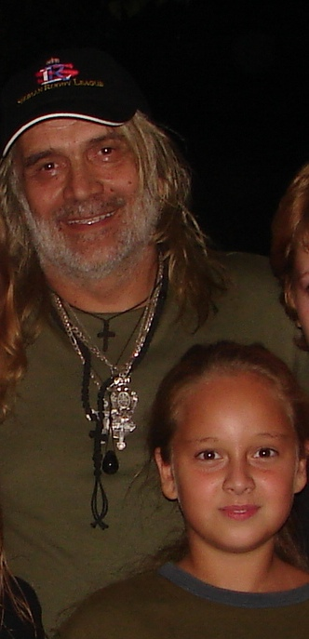
RIBLJA CORBA
Written by Sara VII5
Riblja Corba is popular Serbian rock gang formed in restaurant Sumatovac.in 1978. Members of Riblja Corba are: Bora Djordjevic(lead vocal),Misa Aleksic,Rajko Kojic and Miroslav Milatovic Vucko.At first they called Bora and worriers ,but they changed their name. Albums of Riblja Corba are: Kost u grlu(1979); Pokvarena masta i prljave strasti(1981); Mrtva priroda(1981); Buvlja Pijaca(1982); Veceras vas zabavljaju muzicari koji piju(1984); Istina(1985); Osmi nervni slom(1986); Ujed za dusu(1987); Prica o ljubavi obicno ugnjavi(1988); Koza nostra(1990); Labudova pesma(1992); Zbogom,Srbijo(1993); Ostalo je cutanje(1996); Nojeva barka(1999); Pisanje uz vetar(2001); Ovde(2003) and Trilogija(2005/2006). There are also singles like: Lutka sa naslovne strane; On i njegov BMW; Rokenrol za kucni savet; Valentino iz restorana; Nazad u veliki prljavi grad; Mirno spavaj; Nesrecnice,nije te sramota and Zasto kuce arlauce.

Slide 6
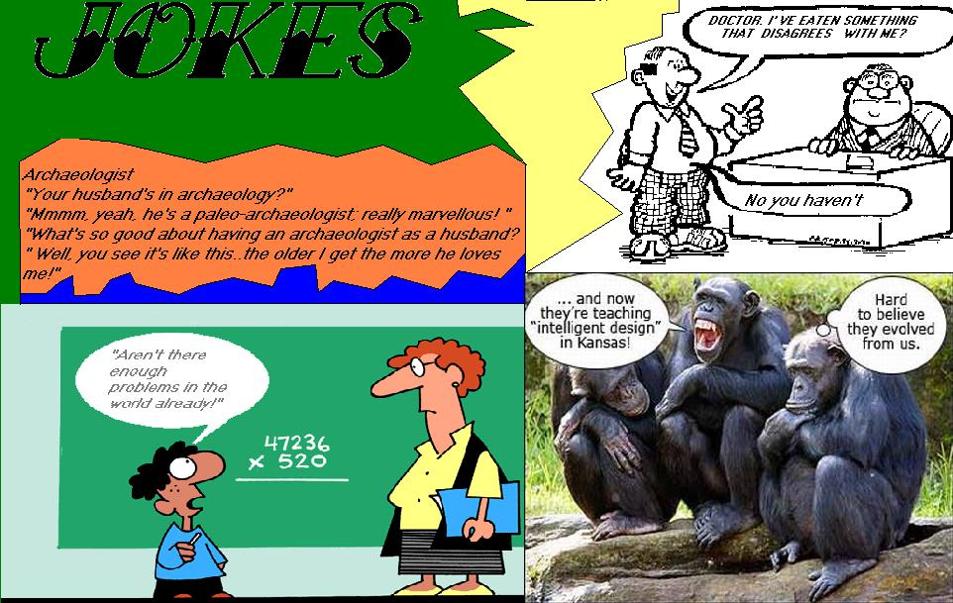
PAGES OF LAUGHTER AND ENTERTAINMENT

Slide 7
Fact or Fiction???

Slide 8
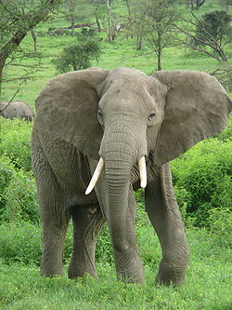
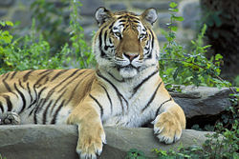
WILDLIFE – elephants and Siberian Tigar
Elephants are in family mammalia. They eat grass and leafage but in case of missing food they eat lop, shrubs and similar food. Elephants are the biggest land mammals alive and today live on ground. Calf s can be heavy about 100
kg. They can live 70 years. The biggest elephant weighted 12.240 kg.
Today there are only 3 kind of elephants-
African elephant
Forest elephant
Asian elephant
Today, elephants are on target of poachers because their ivory is on price
Siberian tiger is the biggest cat in the world. Siberian tiger lives in siberian forest, he hunts like other tigers. They are menace kind of tigers because they have reddish coat decorated with black tracks. Siberian tiger is very strong. He can be long 4 meters , he can weight 100-320 kilos , but the heaviest siberian tiger had a 400 kilos. Siberian tiger lives about between fifteen and twenty years. For one day he can eat 10kg of meat.
He spends lot of time hunting, because just 10% of atacks are succesful.

Slide 9
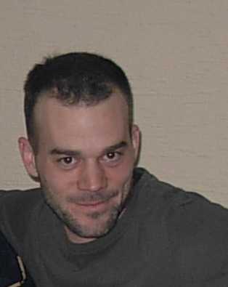
INTERviews The team of “Sweet Years” prepared for you interviews with two teachers of ours, PE teacher and Biology teacher. Read and find out something about them that you didn't know and maybe you were afraid to ask.
SY: Where are you from and how old are you?
Teacher Milan: I’m from Novi Sad and I am 34 years old.
SY: What would you do if you were not teacher? And why?
Teacher Milan: I would be a colledge teacher or a trainer of some sport.
SY: Do you like you job in this school?
Teacher Milan: Yes, i do.
SY: How long have you been teaching?
Teacher Milan: I’ve been working as a teacher for 10 years.
SY: What kind of music do you listen?
Teacher Miilan: Music for the children.....i’m joking. Pop music
SY: Which film is your favorite?
Teacher Milan: Odyisse 2000
SY: What was your biggest problem at school?
Teacher Milan: I hated wearing uniforms at school.
SY: When did you have your first girlfriend/boyfriend?
Teacher Milan: I had my first relationship when I was 15, and first kiss when I was 12 years old.
SY: What was your biggest embarrassment at school?
Teacher Milan: When I came to school and by mistake started to teach children of my college.

Slide 10
I sitcoms “ LOST “
This TV series is about people who found themselves in the same airplane. The thing is that plane crashes down on an island were nobody lives. People are trying to call the rescue team but they can not, so they decide to live there.
“this is one big mixture of characters and people” said one of the actors. In the beginning they think that they are on a remote island but it seems that something is hiding there. Main characters are remembering their past and they are trying to meet each other and to adapt to the environment.

Slide 11
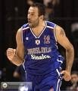
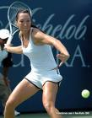
Play sport (not computer games)
In this section we will try to persuade kids to start training something by introducing them sports stars from all over the world. Will we succeed time will tell but still there is a hope that these text are not in vain.
In vain - uzalud

Slide 12
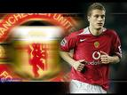
Nemanja Vidic was born in Titovo Uzice in 1981.Titovo Uzice is located in Serbia.Nemanja Vidic is Serbian football player. He plays for English club Manchester United,and for the Serbian national football team. His father’s name is Dragoljub, and his mother name is Zora.He has got older brother Dusan. 1989 he started to play football in Jedinstvo Uzice.When he was 12 he left Jedinastvo Uzice and he went to Sloboda Uzice. His first big club Crvena Zvezda in Belgrade.His position is centre back.Nemanja Vidic is the best Srebian football player.He plays for the best football club in premier ligue.He is at top 30 football players of the world. Date of birth: October 21,1981 Height: 1.88m
SPORT STARS

Slide 13
SCIENCE PAGE robots
At first sight painting and drawing seem to be actions that only man can do. But it is not like that. Robots can do this too. Some robots use TV camera like eyes to watch the portrait of a person they are painting while others search for painting saved in memory of a computer to make picture according to a momentary inspiration. People start making art robots maybe because some painters are giving up painting. Some of them are collecting rubbish and using it they are making robots. Others are making real robots which are programmed to make artist feel scared or phatetic.
Translated by Stevica and Dragana V1

Slide 14
Funny horoscope if you believe……believe
ARIES You must be careful because someone want to kill you.
And you will travel to Bulgaria.
TAURUS Your parents will give you pocket-money.Your partner will leave you.
GEMINI You will travel to Mercur and your spaceship will collide with comet.
CANCER You will meet a rich person and you will fell in love with it!
LION You will find a true love in remote island,but she/he will die.
VIRGO Santa Claus is angry at you and you won't get a present for New Year.
LIBRA You will travel to England.You will get a money from lottery.
SCORPION You don't have luck with lottery,but you will get big heidrom.
You will have luck with love and finally you will find a soulmate.
Your friend will pay a travel for you and him to Maldivi.
SAGITTARUS Since Hallowen you are acting very strange,and your friends are woried for you.
CAPRICORN :You will travel to Mexico and you will sat on cacuts.
AQUARIOUS You will go to Portugal and have a great time.
PISCES You are fortunate this month. Somebody will pay you a visit

Slide 15
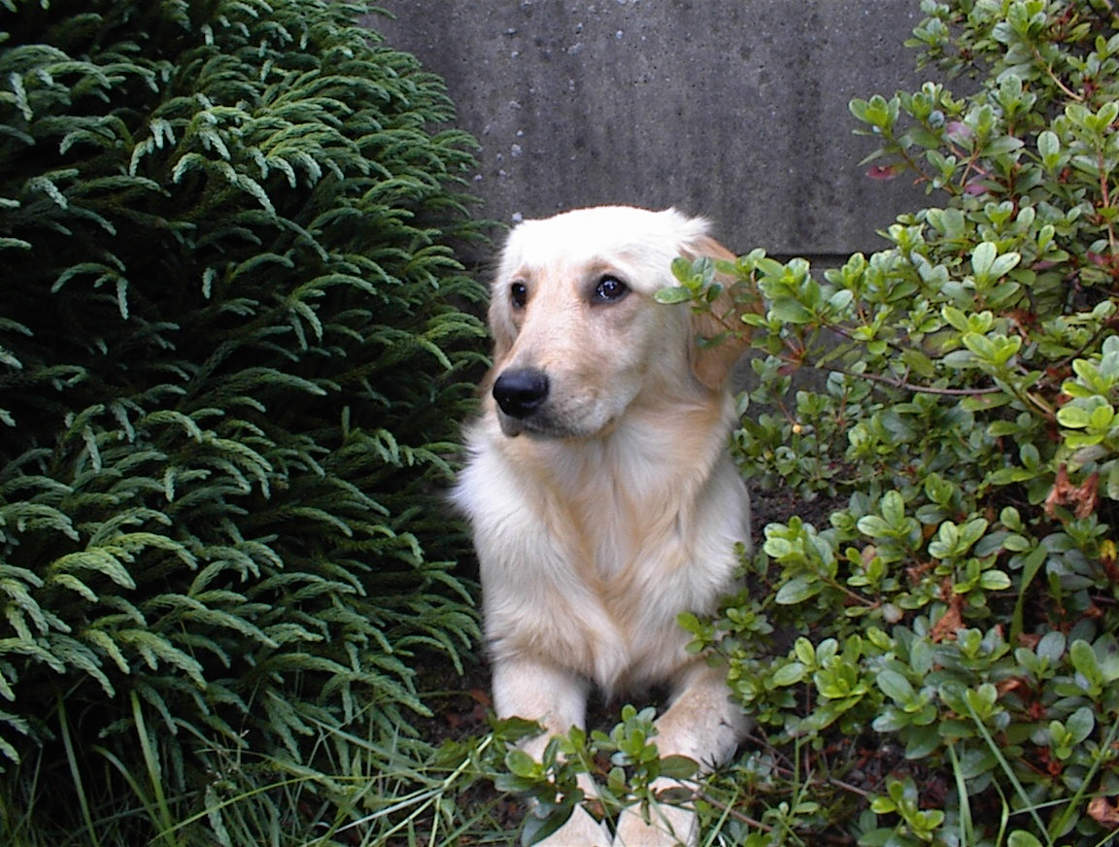
MY PET – golden retriever
According to a tradition golden retriever came from
old Sheppard dogs from the Caucasus which
were trained for circuses and which were
brought to Bridgton, England. Astonished
by these dogs sir Dudley Majoribank future
Lord Tweedmouth bought them all from fair’s actors
in order to crossbreed them with a Saint Hubert dog.
Some dog experts believe that Golden is a descendant of
yellow dog which appeared as a result of crossbreeding
water spaniel and flat coated retriever.
Golden retriever is very active and strong. This dog has
especially developed sense of smell and is a great
hunter. It is also proved to be good guide for the blind.
This dog is very capable guardian, calm and tender
to children so it is very appreciative as a dog for company.
Golden retriever has a healthy look, strong body, certain
and regular moving and gentle expression. It has a wide
skull with strong snout and jaws. Its eyes are dark and
separated and look is gentle as well. Eyelids are dark.
Triangle shaped eyes are of middle length and they are placed horizontally to a head. Thorax is deep, legs are muscular.
Tail is long; lightly bend and it should not be too raised. The coat is flat or wavy with beautiful locks with thick and rich undercoat.
It appears in all shades of golden yellow color. A few white
hairs
on its chest is approved but the coat must not be reddish or mahogany . poorly mass, weak skeleton, bad tail posture, bright eyes, curly coat, shortage of undercoat and unstable character are considered to be very serious defects.

Slide 16
The WINNERS Marija ,Marijana and Verica V4
There is a girl. I know her. She’s name is . She has blond hair and beautiful blue eyes. Her dad called Slobodan, he is very industrious man. Why I love her? To tell you I don’t know. But Milena is my big love from the last year. So I looking her and she me….. And she not observe. She sit on the wall with her friends and talking something. Perhaps talking about me?! Ah, that will be good, that I am the main topic. Never mind . Who know what everything can happen. I have lot of time to find my happiness, I have more time to find second blond, brown, black hair and beautiful eyes, it's not important what colour they are. Yes, I’m still young.

Slide 17
Don’t be lazy, be popular!!
If you want to be popular in your school take a part in our educative game. What you have to do is to solve the following crossword in English. The student whose crossword is pulled out of the box will be given a page in our magazine. He/She will be interviewed and photographed.

Slide 18
This magazine exists thanks to:
Biljana Miletic
Miroslava Ivanov
Radmila Topalski
Snezana Đoric
Dragica Ćurčin
Branka Mrkšić
Nemanja Dobanovacki
Marko Ivkov
Borislav Stojsin
Sara Lapadat
Ksenja Stajic
Marija Cvjetkovic
Stevica Mitrovic
Dragana Arsin

